Slide 1

Noida Institute of Engineering and Technology, Greater Noida
6th Semester Mini Project ECOMMERCE WEBSITE
Presented To:
Ms. Aarushi Thusu
Ms. Neelam
Department of CSE-AIML
Presented By:
Riya Singh (2201331530161)
Shraddha Tripathi(2201331530177)
AIML-A

Slide 2
Noida Institute of Engineering and Technology, Greater Noida
PROBLEM STATEMENT :
Modern e-commerce websites often lack intelligent customer interaction and efficient admin management tools. Users face delays in getting answers to common queries, while admins struggle to manage products, orders, and customers efficiently. There's a need for a scalable, secure, and intelligent e-commerce system that supports both seamless shopping for users and efficient control for admins. Integrating a machine learning chatbot can solve user queries instantly, boosting engagement and satisfaction.

Slide 3

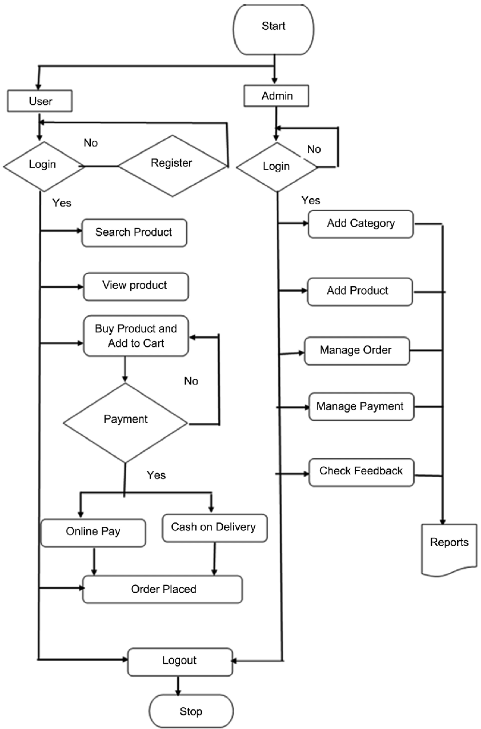
FLOW OF THE PROJECT

Slide 4
TECHNOLOGY USED
Frontend :React JS/Tailwind CSS for responsive UI.
Backend:Node.js+Express for API development
Database:MongoDB for mongoose for data storage
Authentication:JWT(JSON WEB TOKEN)
Ml Chatbot:Trained with NLP using Python
Deployment:Hosted using platforms like Vercel/Netlify

Slide 5
FEATURES OF THE PROJECT
👤 User Features
✅ User Registration and Login (with JWT Authentication)
🛍️ Browse Products by Category or Search
➕ Add to Cart / Remove from Cart
📦 Place Orders with Order History Tracking
🤖 Chat with ML Chatbot for Help (e.g., order status, return policy)
✍️ View and Update Profile Information
🔒 Secure Checkout Process
📧 Get Email Confirmations on Orders
🛠️ Admin Features
🔐 Admin Login with Role-Based Access
🧾 Add, Update, or Delete Products
📋 View and Manage All Orders
👥 Manage Users (View/Delete)
📈 Dashboard with Summary of Orders, Users, and Products
🗂️ Manage Product Categories
🤖 Monitor Chatbot Interactions (optional analytics for future)

Slide 6
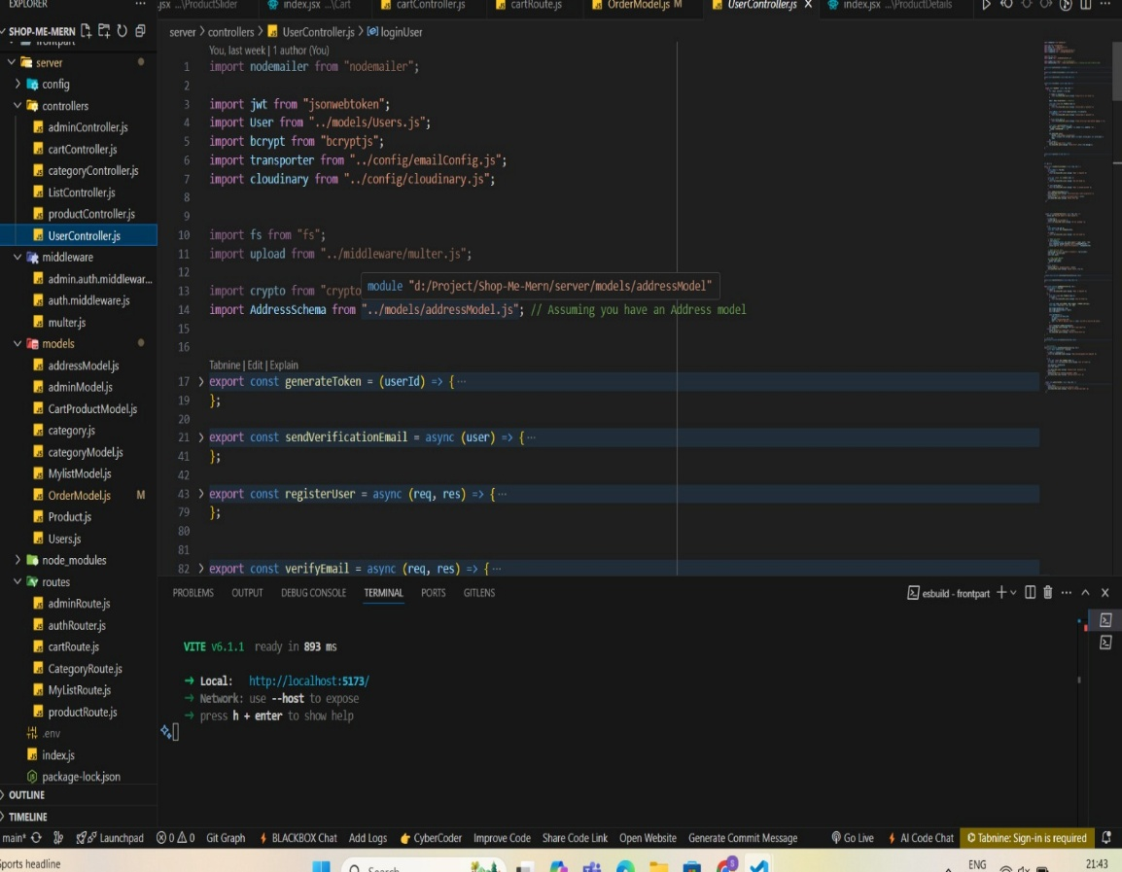
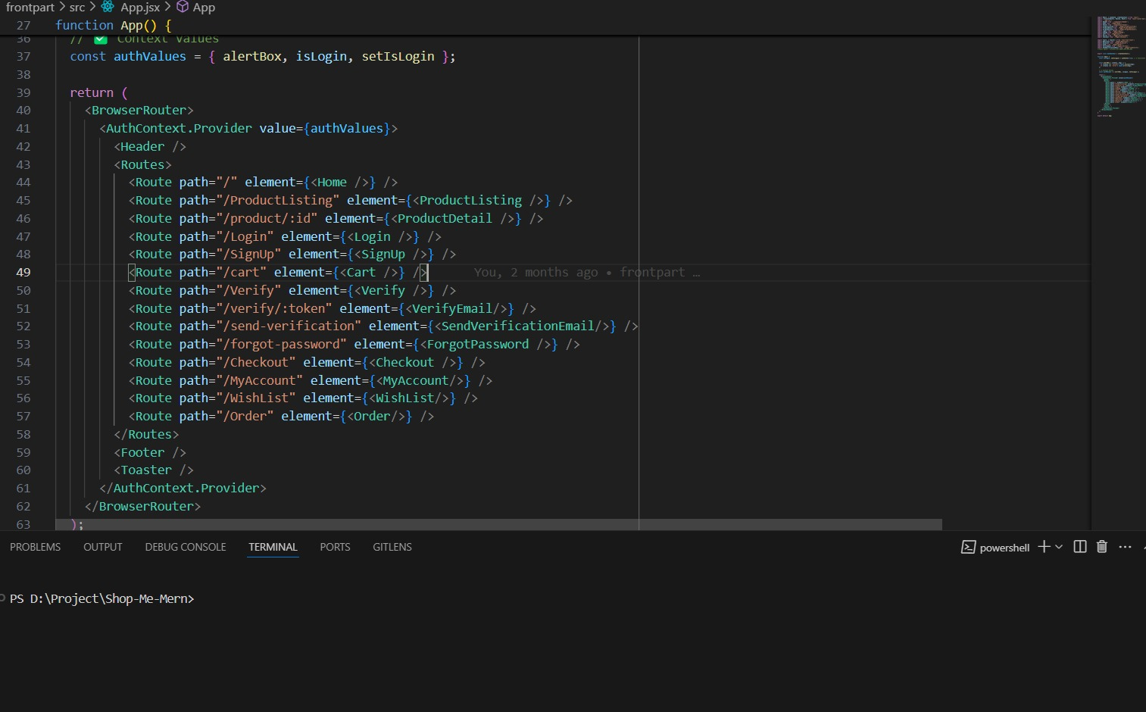
SNAPSHOTS OF THE PROJECT

Slide 7
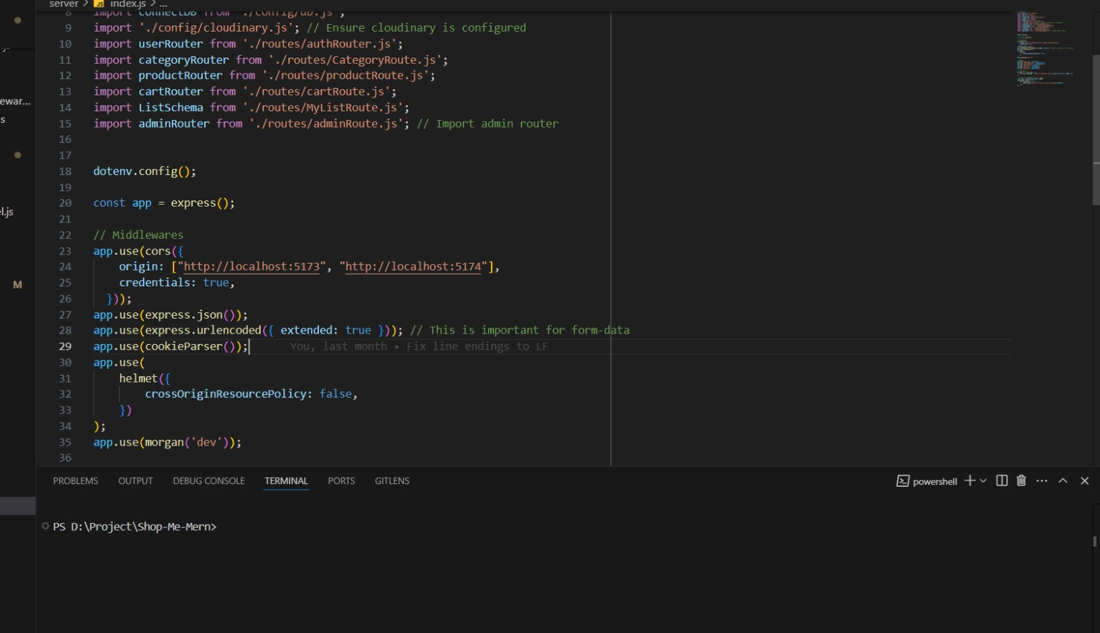
SNAPSHOTS OF THE PROJECT

Slide 8
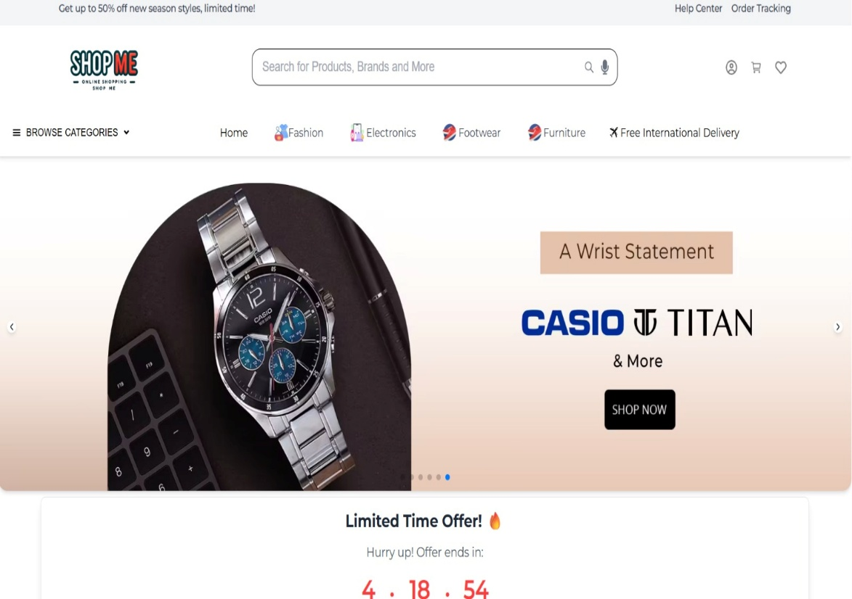
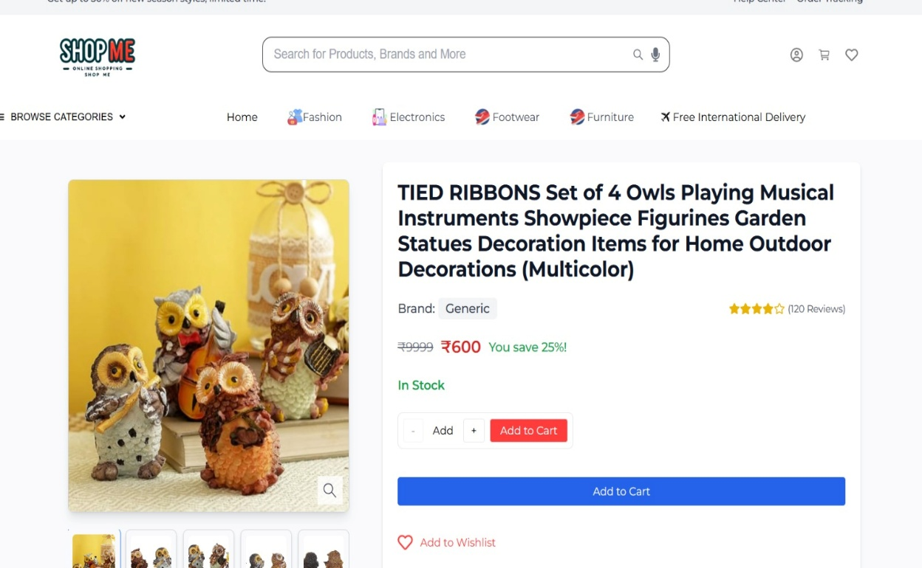
OUTPUT OF THE PROJECT

Slide 9
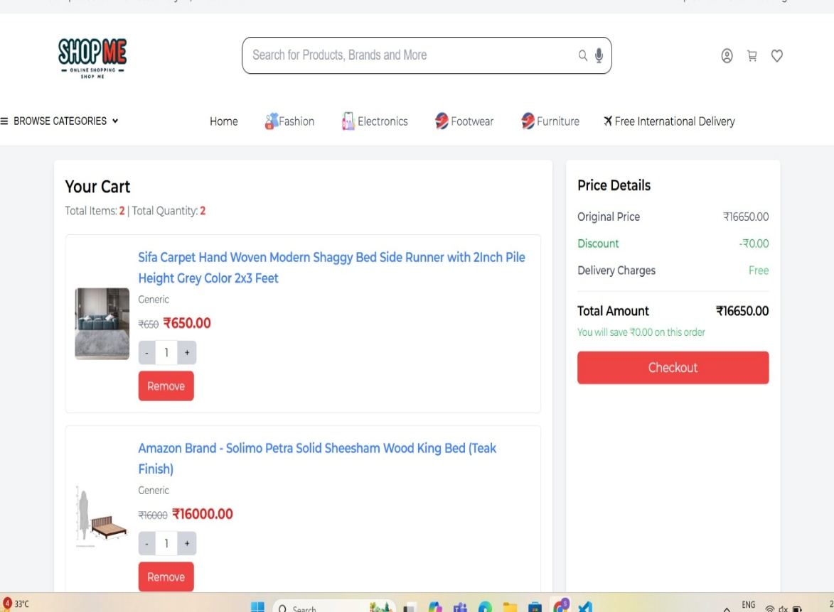
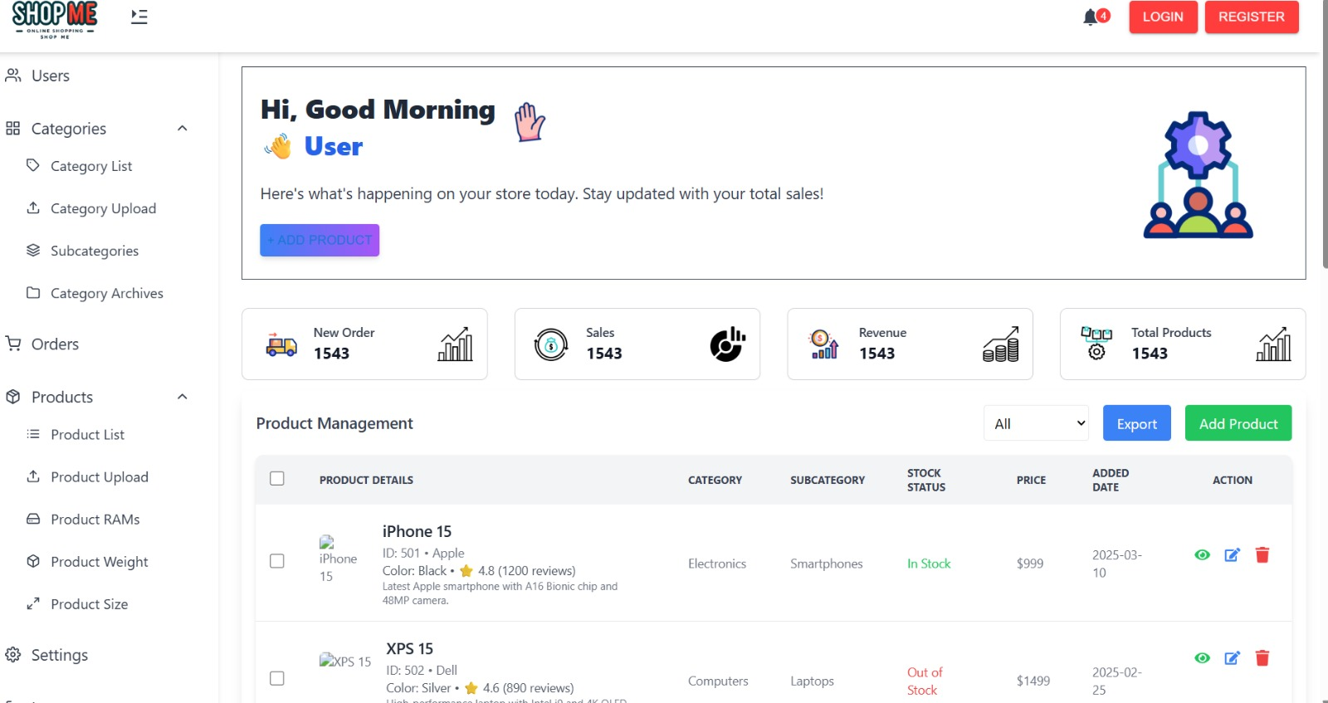
OUTPUT OF THE PROJECT

Slide 10
FUTURE GOALS
🔐 Integrate Secure Payment Gateways
(e.g., Razorpay, Stripe, PayPal)
🧠 Enhance ML Chatbot with Deep Learning
(Context-aware responses using LSTM/Transformer models)
🌐 Multi-Language Support in Chatbot
(Improve accessibility for diverse user bases)
📊 Admin Analytics Dashboard
(Visualize sales, traffic, and user behavior)
🎯 Recommendation System
(ML-based product suggestions based on user behavior)
🔁 Order Return & Refund Module
(Add easy return/refund options for users)

Slide 11
SCOPE OF THE PROJECT
Can be deployed as a commercial e-commerce solution.
Scalable to handle thousands of products and users.
Can serve as a foundation for startups or businesses.
Extendable to other domains: grocery, electronics, fashion, books, etc.
Offers a blend of AI-driven interaction and full-stack architecture, suitable for academic, professional, or enterprise projects.

Slide 12

REFERENCES
React Documentation – https://react.dev/learn
Express Documentation – https://expressjs.com
Youtube

Slide 13


